Slide 1
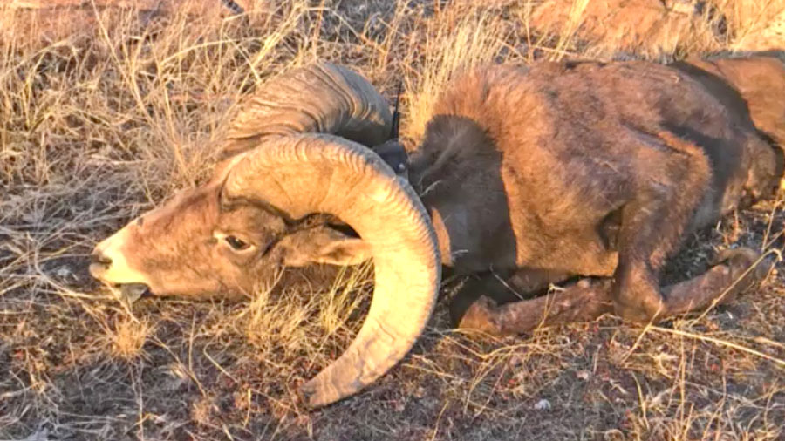
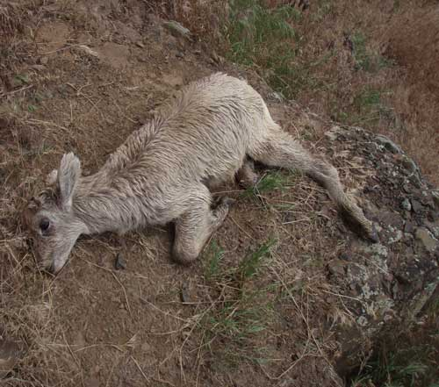
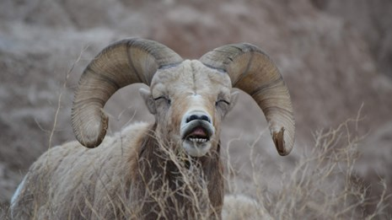
Pneumonia and Bighorn Sheep
How do domestic sheep farms contribute to native western caprine population decline due to pneumonic infections?
https://www.nps.gov/articles/bhs-pneumonia.htm
https://ksltv.com/406207/antelope-islands-bighorn-sheep-herd-sick-lethally-removed/
http://bighornhealth.org/about-pneumonia
Will Parker, Kevin Henry, Mara Bugler, Maggie Carroll, Chelsea Priest, and FaithAnn Vanderwalker

Slide 2
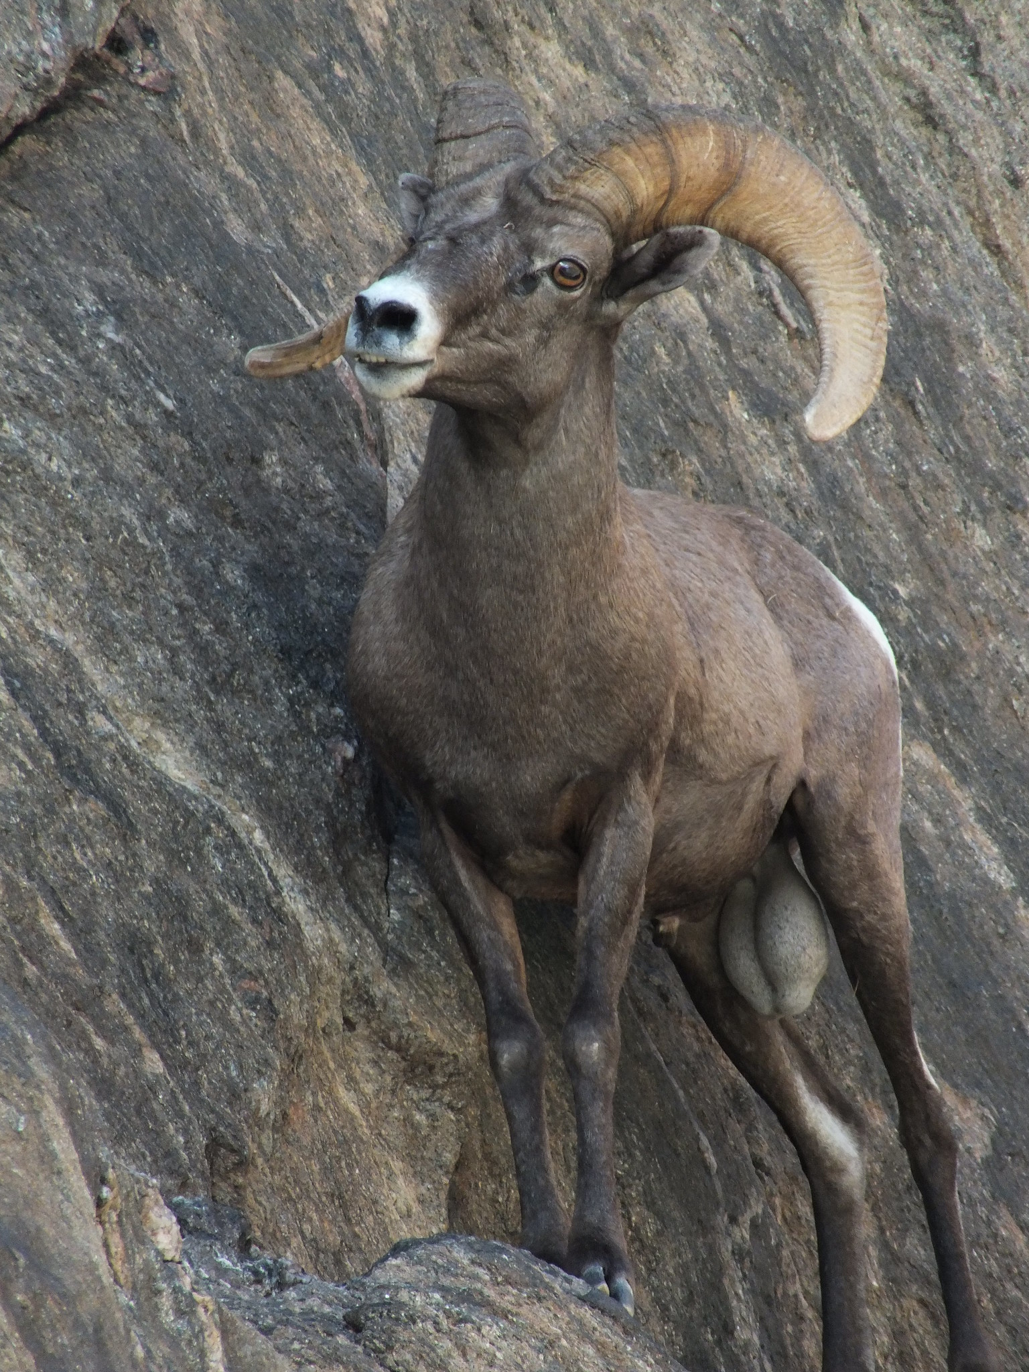
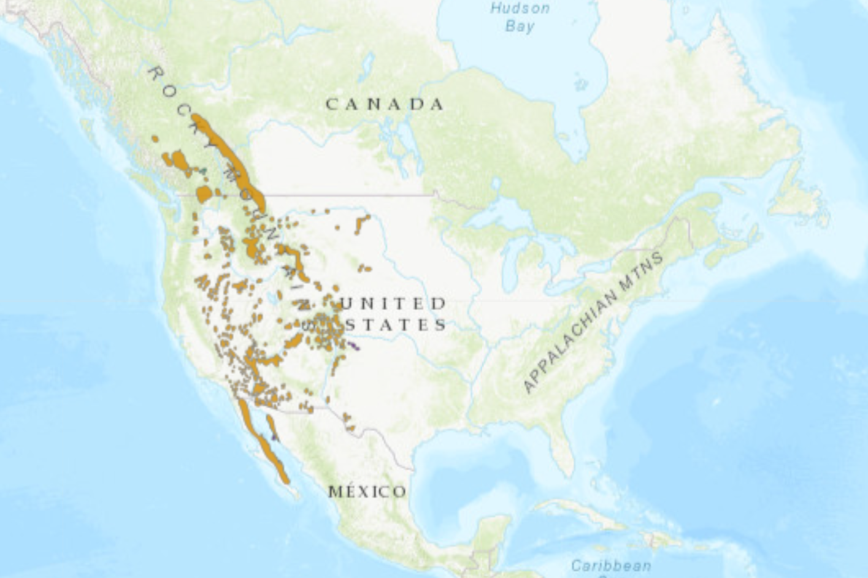
A Background into Bighorn Sheep
Bighorn sheep (Ovis canadensis) are members of the Bovidae family that reside in the Mountainous Western Region of the United States from southern Canada into Mexico.
They prefer grassland and rocky areas; as in those habitats they can find food and evade predators by utilizing their outer hooves that are shaped to snag any slight protrusion. A soft inner pad on the hoof provides a grip that conforms to the rocky surfaces
In general, O. canadensis is listed on the IUCN as stable and of least concern with approximately 49,000 mature individuals in the wild
Although Bighorns are listed as of “Least Concern”, the North American population was estimated to be around 1.5 to 2 million in the 19th century. Population decline has been caused by human encroachment.
https://today.oregonstate.edu
(IUCN 2019), (“Bighorn Sheep” n.d.)

Slide 3
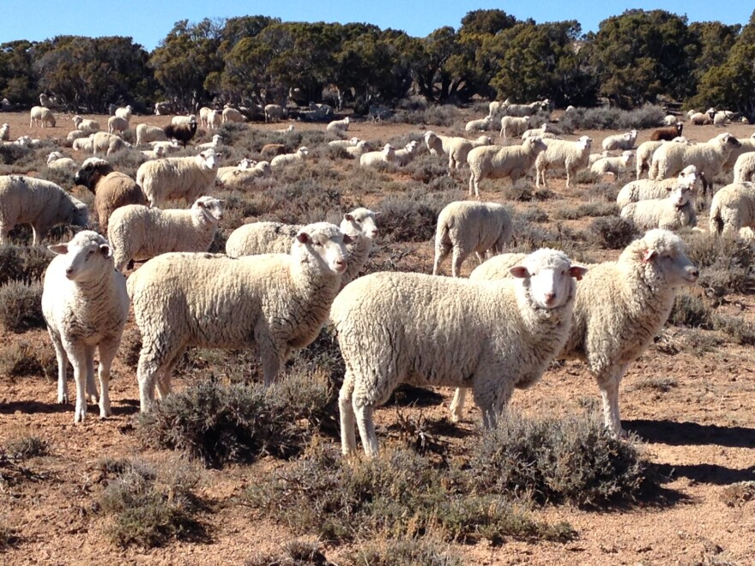
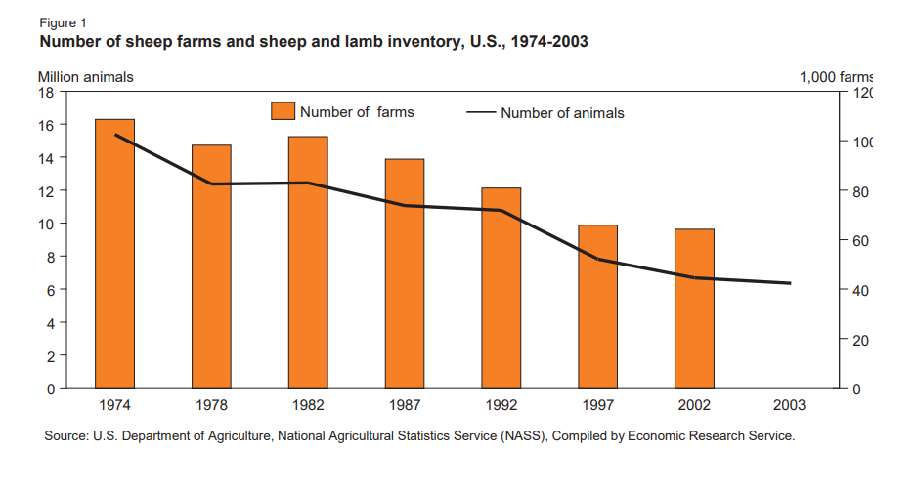
A Background into Domestic Sheep
Domestic sheep (Ovis aries) are very close relatives to native bighorn sheep however they originate from the old world
Domestic sheep have evolved a herding instinct
As of Jan 1st, 2022, there were approximately 3.71 million breeding sheep and 1.36 million market sheep in the United States. Population numbers used to be higher but have been in decline since the 1970s
Sheep are so abundant in the United States for the vast number of resources they produce. Sheep are harvested for their meat, milk, hide, and obviously, their wool.
In 2018, the US wool industry earned farmers 42.77 million dollars in revenue
That number might not seem like much, but it has been decreasing as the price of wool decreases and the number of sheep in the US decreases.
www.wyomingpublicmedia.org
(Jones n.d), (USDA n.d.), (Reavill n.d.), “Total U.S. shorn wool production value 2018” n.d.)
Notes:
Herding instinct keeps sheep close together which helps transmit diseases

Slide 4

Bighorn and Domestic Sheep
Domestic sheep (Ovis aries ) - resilient Bighorn sheep (Ovis canadensis) - non-resilient

Slide 5
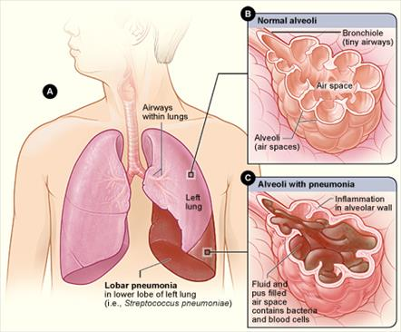
Pneumonia in Sheep
An infection of the lungs caused by bacteria, viruses, and/or parasites
Effects all age classes
Poor living conditions
Dust
Excess fecal matter
Unstable temperatures/humidity
Stress
Mainly caused by Ovine Progressive Pneumonia Virus (OPPV) in adults (Mycoplasma ovipneumoniae)
Mainly from fluid entering the lungs in the young
Not a sheep
(“Pneumonia in Sheep and Goats | OSU Sheep Team” n.d.)

Slide 6
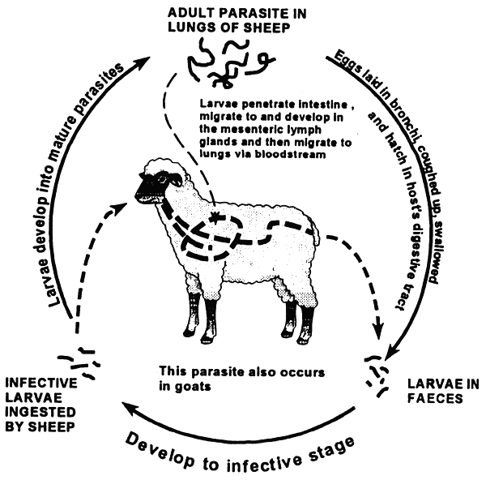
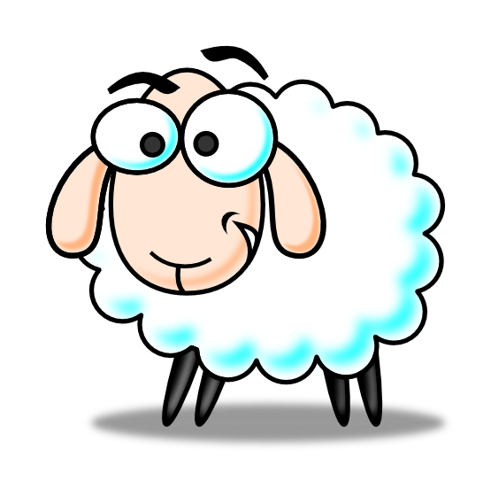
_

Slide 7
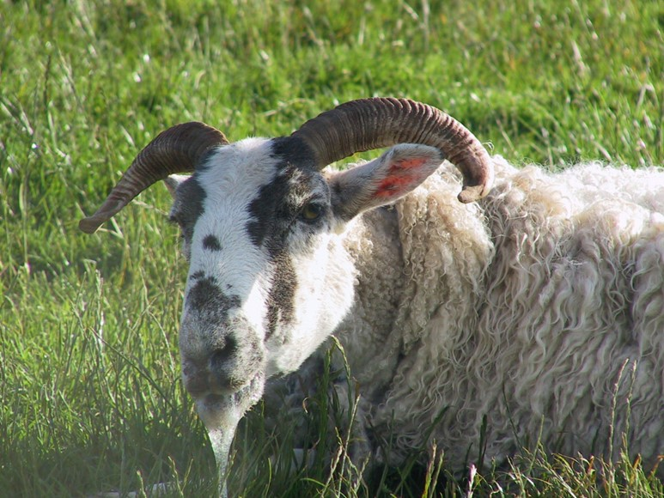
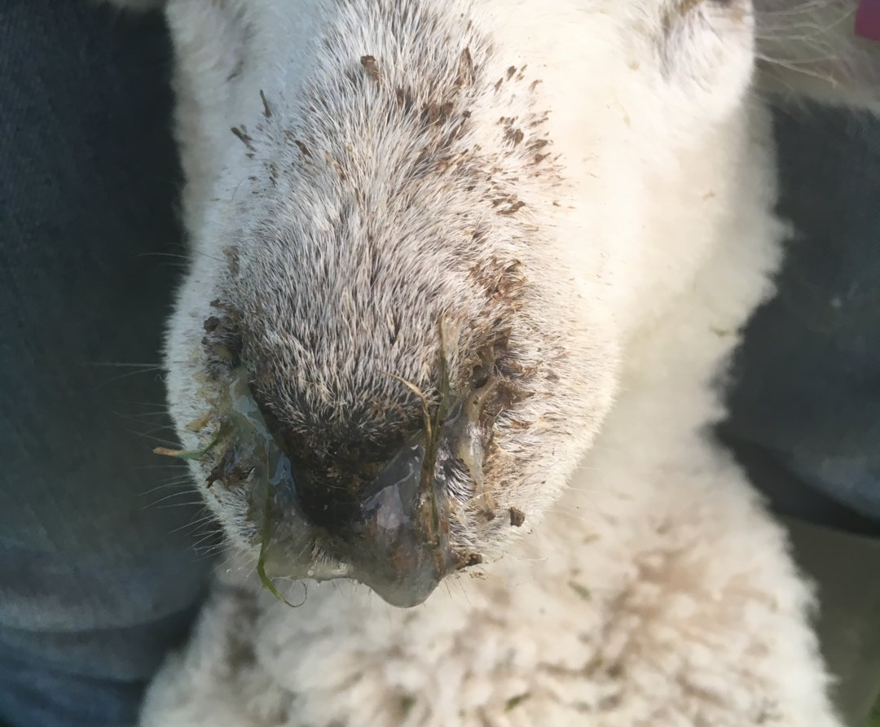
Symptoms
Coughing and labored breathing
Decreased movement/activity
Fever
Thick yellowish nasal discharge
(“Pneumonia in Sheep and Goats | OSU Sheep Team” n.d.)

Slide 8
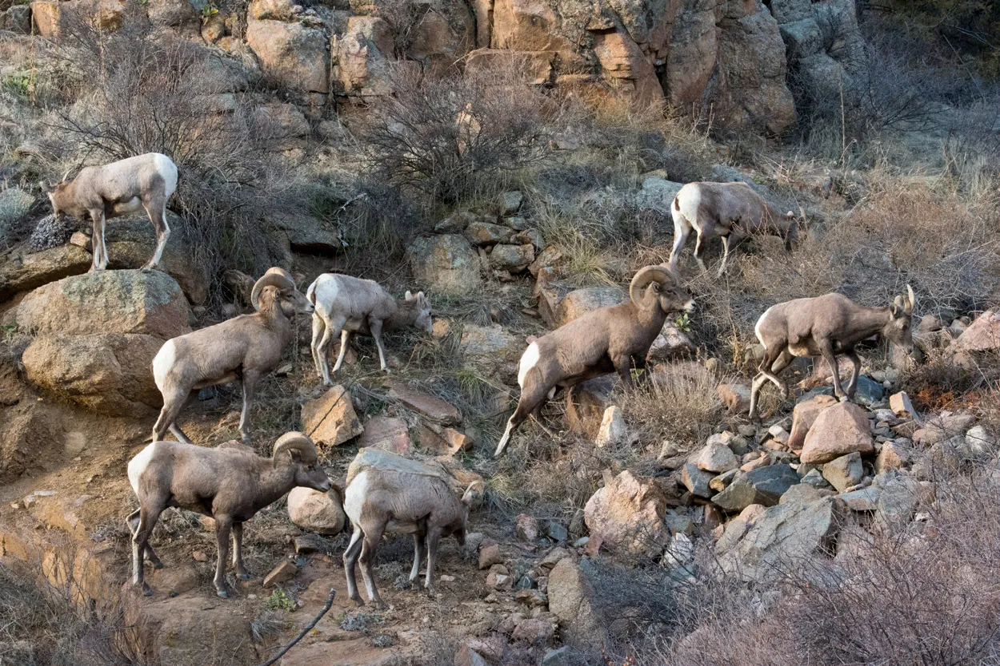
How does Sheep Pneumonia Impact Bighorn Sheep
Populations?
Pneumonia-causing bacterial infection spreads from domestic livestock to wild Bighorn populations that haven’t built up immunity
Contact through grazing on public land
Bacterial infection persists long-term
Infection can be detected using nasal swabs
Pneumonia presence determined
post-mortem; not effective for management
Rapid declines
Pneumonia can cause >50% population
mortality across age classes
Severely limits population restoration
Mcclintock and White 2007; Sells et al. 2016)
https://coloradooutdoorsmag.com/2022/01/15/the-bighorn-bloodline/

Slide 9
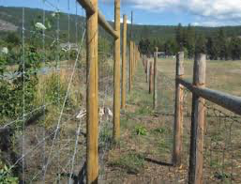
What Strategies are Currently Being Implemented to Stop the Spread
Currently, Wildlife management agencies and non-governmental organizations are actively trying to reduce contact between wild and domestic sheep through a combination of regulations on public plans, outreach programs and education on private lands.
Some methods that have been practiced to reduce contact include double-fencing domestic sheep flocks in wild sheep habitat, using additional guard dogs, penning domestic sheep at night and counting dometic sheep more frequently.
Other strategies wildlife managers have tried is administering antibiotics, selective culling, and partial or complete depopulation
Strategies used to increase individual resistance to pneumonia include improving nutritional conditions, increasing genetic diversity, and modifying spatial structuring.
(Cassirer et. Al, 2018)
Notes:
Cassirer, E. F., K. R. Manlove, E. S. Almberg, P. L. Kamath, M. Cox, P. Wolff, A. Roug, J. Shannon, R.
Robinson, R. B. Harris, B. J. Gonzales, R. K. Plowright, P. J. Hudson, P. C. Cross, A. Dobson, and T. e. Besser. 2018. Pneumonia in Bighorn Sheep: Risk and Resilience. The Journal of Wildlife Management 82: 32–45.

Slide 10
Have These Strategies Proven to Be Effective?
Restricting public grazing in Rocky Mountain National Park enabled the herd to increase from 200 to 700 until another outbreak occurred in the late 90s ¹
Double fencing is impractical as well as too expensive on a large scale where private farmers graze domestic sheep on public land. The potential of vaccines has also proven to be too expensive and not worth it to the farmers who rarely suffer losses due to the disease.
Hard to track prevention as it is hard to track the spread of the disease without performing necropsies^{. 2}
Public outreach and education has been somewhat effective as there is dedicated funding being provided by hunting tags, and nonprofit support among other federal resources. ²
¹ Mcclintock, B. T. and G. C. White. 2007.
² Cassirer 2022

Slide 11
What Strategies Can Be Used To Stop the Spread in a Perfect World?
Vaccine development and implementation
→ There are multiple strains of sheep pneumonia, and vaccinating against all of them can prove to be a struggle. A vaccination would also need to protect against both infection and disease.
Studying the differences in immunity between domestic and wild populations
→ The science behind the differences in immunity is still widely understudied and unknown between wild and domestic populations. Not only does variation occur between the two species, but among individuals of the same species as well. While some remain unaffected by this infection, others are fatally infected.
Overcoming struggles with ranchers and their willingness to treat or vaccinate their sheep
→ Even if an effective vaccine were to be developed, there are always risks involved in administering these vaccines. Because of this, many ranchers would be understandably hesitant in vaccinating their sheep, and would likely push back against it.
Cassirer et al. 2018

Slide 12
References
Bighorn Sheep. (n.d.). . https://www.nwf.org/Home/Educational-Resources/Wildlife-Guide/Mammals/Bighorn-Sheep.
Cassirer, E. F., K. R. Manlove, E. S. Almberg, P. L. Kamath, M. Cox, P. Wolff, A. Roug, J. Shannon, R.
Robinson, R. B. Harris, B. J. Gonzales, R. K. Plowright, P. J. Hudson, P. C. Cross, A. Dobson, and T. e. Besser. 2018. Pneumonia in Bighorn Sheep: Risk and Resilience. The Journal of Wildlife Management 82: 32–45.
Cassirer, Frances. November, 27, 2022. E-mail Interview.
Pneumonia in Sheep and Goats | OSU Sheep Team. (n.d.). . https://u.osu.edu/sheep/2018/08/14/pneumonia-in-sheep-and-goats/.
Manual on meat inspection for developing countries. (n.d.). . https://www.fao.org/3/t0756e/T0756E06.htm.
IUCN, M. F.-B. (IUCN S. C. S. 2019. IUCN Red List of Threatened Species: Ovis canadensis. IUCN Red List of Threatened Species.
Jones, K. (n.d.). Trends in the U.S. Sheep Industry:40.
Mcclintock, B. T. and G. C. White. 2007. Bighorn sheep abundance following a suspected pneumonia
epidemic in Rocky Mountain National Park. Journal of Wildlife Management 71: 183–189.
Meyer, B. (n.d.). SHEEP, LAMB, AND GOAT INVENTORY JANUARY 1, 2022:2.
Reavill, C. (n.d.). Ovis aries (mouflon). https://animaldiversity.org/accounts/Ovis_aries/.
Sells, S. N., M. S. Mitchell, V. L. Edwards, J. A. Gude, and N. J. Anderson. 2016. Structured Decision
Making for Managing Pneumonia Epizootics in Bighorn Sheep. The Journal of Wildlife Management 80: 957–969.
Total U.S. shorn wool production value 2018. (n.d.). . https://www.statista.com/statistics/194423/total-wool-production-value-in-the-us-since-1999/.

